Slide 1


Investigate Business Hotel using Data Visualization
Created by:
Muhammad Cikal Merdeka
Email : mcikalmerdeka@gmail.com
LinkedIn : linkedin.com/in/mcikalmerdeka
Github : github.com/mcikalmerdeka
Dedicated entry-level data scientist with analytical and experimental background of Physics. My graduation 2023, a pivotal year marked by significant advancements in artificial intelligence with the introduction of GPT-4 and other generative AI models, has fueled my curiosity and excitement to delve into the field of data. I have comprehensive grasp of data science methodology from business understanding to modelling process with proficiency in Python, SQL, Tableau, Power BI, Looker Studio and other tools related to data analytics workflow from several coursework and bootcamps.

Slide 2
Project Overview
The hospitality industry encompasses businesses that provide accommodation for guests, including room reservations, meals, and other facilities. It can range from small to large enterprises, from one-star to five-star hotels. Success in this industry depends on factors such as location, service quality, and competitive pricing. The demand for comfortable and affordable accommodation makes the hotel business a viable option for entrepreneurs. It's important to understand the target market and the health of the hotel business to devise appropriate strategies and provide services and facilities tailored to their needs.
This project will analyze the hotel business by processing historical data to obtain information about hotel bookings, length of stay, and the time interval between booking and cancellation. In this project we will be using Python for main programming language with the help of several libraries such as numpy and pandas for data preprocessing while for data visualization will be done with the help of matplotlib and seaborn.

Slide 3
Data Description
Dataset Description :
This data set contains booking information for a city hotel and a resort hotel, and includes information such as when the booking was made, length of stay, the number of adults, children, and/or babies, and the number of available parking spaces, among other things. All personally identifying information has been removed from the data.
Feature Information :
hotel : Hotel (Resort Hotel or City Hotel)
Is_canceled : Value indicating if the booking was canceled (1) or not (0)
Lead_time :Number of days that elapsed between the entering date of the booking into the PMS and the arrival date
Arrival_date_year : Year of arrival date
arrival_date_month : Month of arrival date
arrival_date_week_number : Week number of year for arrival date
arrival_date_day_of_month : Day of arrival date
For more details, you can view the Jupyter notebook here.

Slide 4
Data Description
Stays_in_weekend_nights : Number of weeked nights (Saturday or Sunday) the guest stayed or booked to stay at the hotel
Stays_in_weekdays_nights : Number of week nights (Monday to Friday) the guest stayed or booked to stay at the hotel
Adults : number of adults
Children : number of children
Babies : number of babies
Meal : type of meal booked
City : city of origin
Market_segment : Market segment designation. Context : the term “TA” means “Travel Agents” and “TO” means “Tour Operators”
Distribution_channel : ooking distribution channel.
Is_prepeated_guest : Value indicating if the booking name was from a repeated guest (1) or not (0)
Previous_cancellations : Number of previous bookings that were cancelled by the customer prior to the current booking
For more details, you can view the Jupyter notebook here.

Slide 5
Data Description
Previous_bookings_not_cancelled : Number of previous bookings not cancelled by the customer prior to the current booking
Booking_changes : Number of changes/amendments made to the booking from the moment the booking was entered on the PMS until the moment of check-in or cancellation
Deposit_type : Indication on if the customer made a deposit to guarantee the booking. This variable can assume three categories:
No Deposit – no deposit was made;
Non Refund – a deposit was made in the value of the total stay cost;
Refundable – a deposit was made with a value under the total cost of stay
Agent : ID of the travel agency that made the booking
Company : ID of the company that made the booking
Days_in_waiting_list : Number of days the booking was in the waiting list before it was confirmed to the customer
For more details, you can view the Jupyter notebook here.

Slide 6
Data Description
Customer_type : Type of booking. Assuming one of four categories :
Contract - when the booking has an allotment or other type of contract associated to it;
Group – when the booking is associated to a group;
Transient – when the booking is not part of a group or contract, and is not associated to other transient booking
Transient-party – when the booking is transient, but is associated to at least other transient booking
Adr : Average Daily Rate as defined by dividing the sum of all lodging transactions by the total number of staying nights
Required_car_parking_space : Number of car parking spaces required by the customer
Total_of_special_request : Number of special request made by the customer
Reservation_status : Reservation last status, assuming one of three categories :
Canceled – booking was canceled by the customer
Check - out customer has checked in but already departed
No-show – customer did not check-in and did inform the hotel of the reason why
For more details, you can view the Jupyter notebook here.

Slide 7
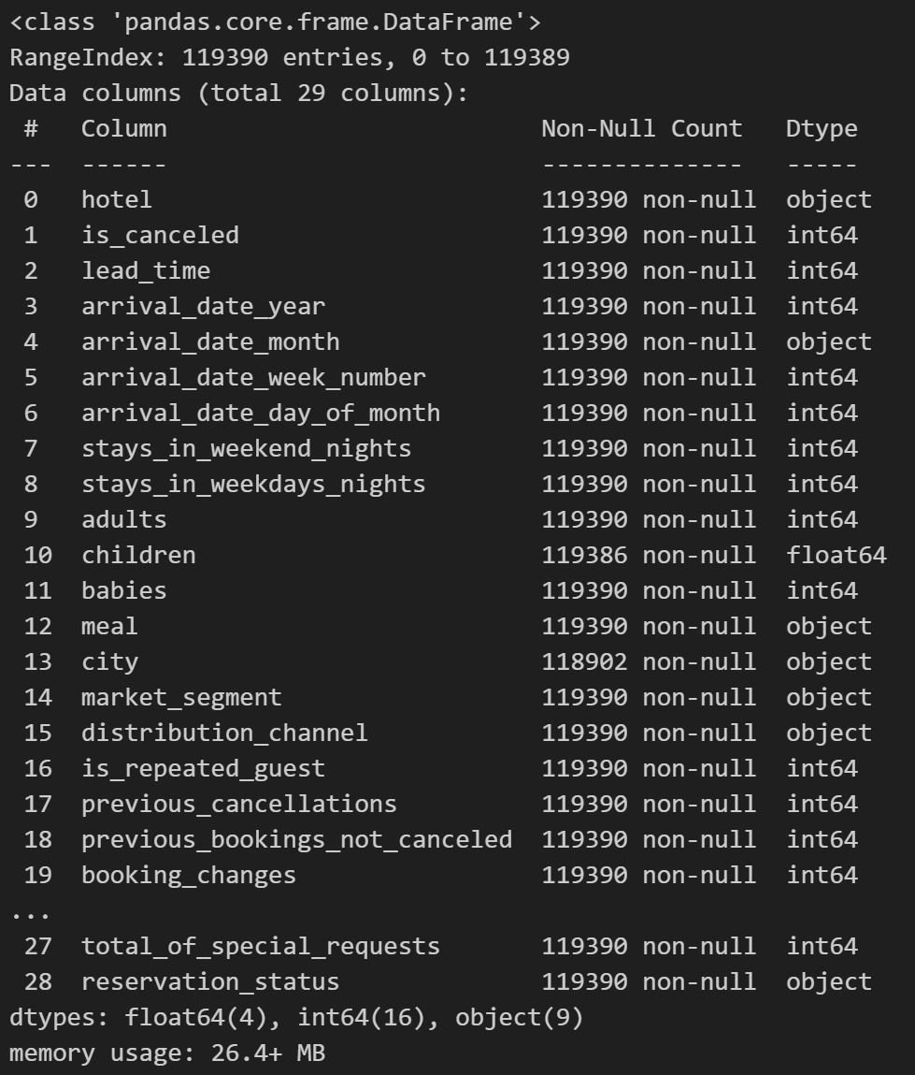
Data Cleansing and Preprocessing
Dataset Information :
The dataset comprises 29 columns and 119,390 rows of data, featuring three types of data: int64, object, and float64. Notably, several columns contain missing values :
Company : 94% null values, affecting 112,593 rows.
agent : 13% null values, impacting 16,340 rows.
City : 0.4% null values, affecting 488 rows.
Children : contains 0.003% null values, impacting 4 rows.
For more details, you can view the Jupyter notebook here.

Slide 8
Data Cleansing and Preprocessing
Duplicate rows will not be dropped due to not having the unique identifier that we can rely on like customer ID or order ID
Imputation with 0 for company, agent, and children
Imputation with mode for city
Handling Invalid Values
Transform & Filter Data
Handling Missing Values
Handling Duplicated Values
Transform for ‘undefined’ values in meal, market_segment, and distribution_channel
meal → No Meal, market_segment → Online TA, distribution_channel → TA/TO
Filtering by total guest (number of guest <=0), stay_duration (night duration < 0), and ADR < 0 (drop due to calculation error)
For more details, you can view the Jupyter notebook here.

